Slide 1


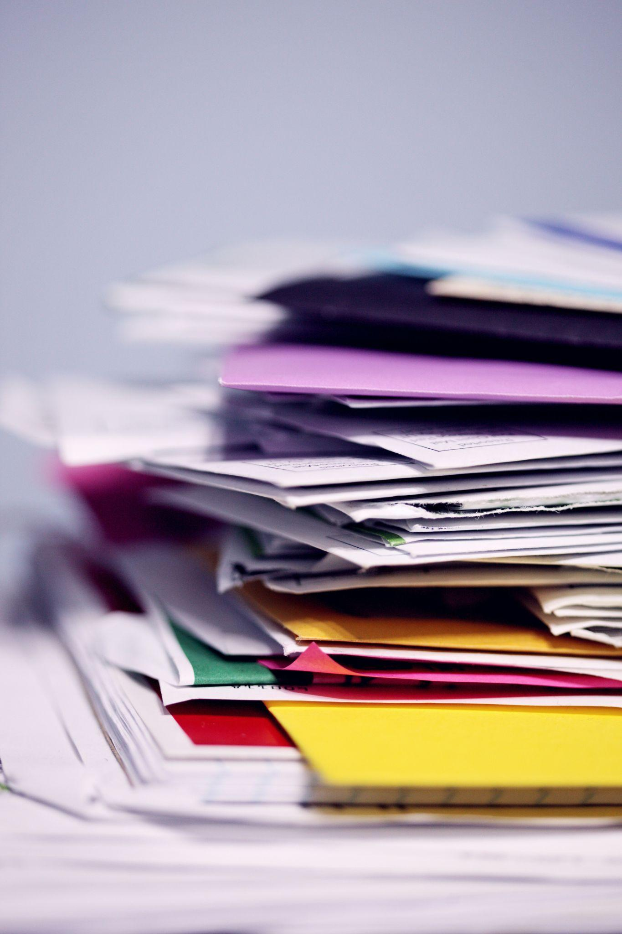



3/18/2025
PROJECT OVERVIEW
MIRC-F Multimodal Information Retrieval Challenge - Failed
Zack and Luis
Image Credit: Fifth Dimension Team
Notes:
(Z)Hello everyone, for the final presentation, Luis and I are going to take you along with us on our adventure into document retrieval. Let’s start with an exercise. I will give you a prompt and you will retrieve the answer from the given information.

Slide 2
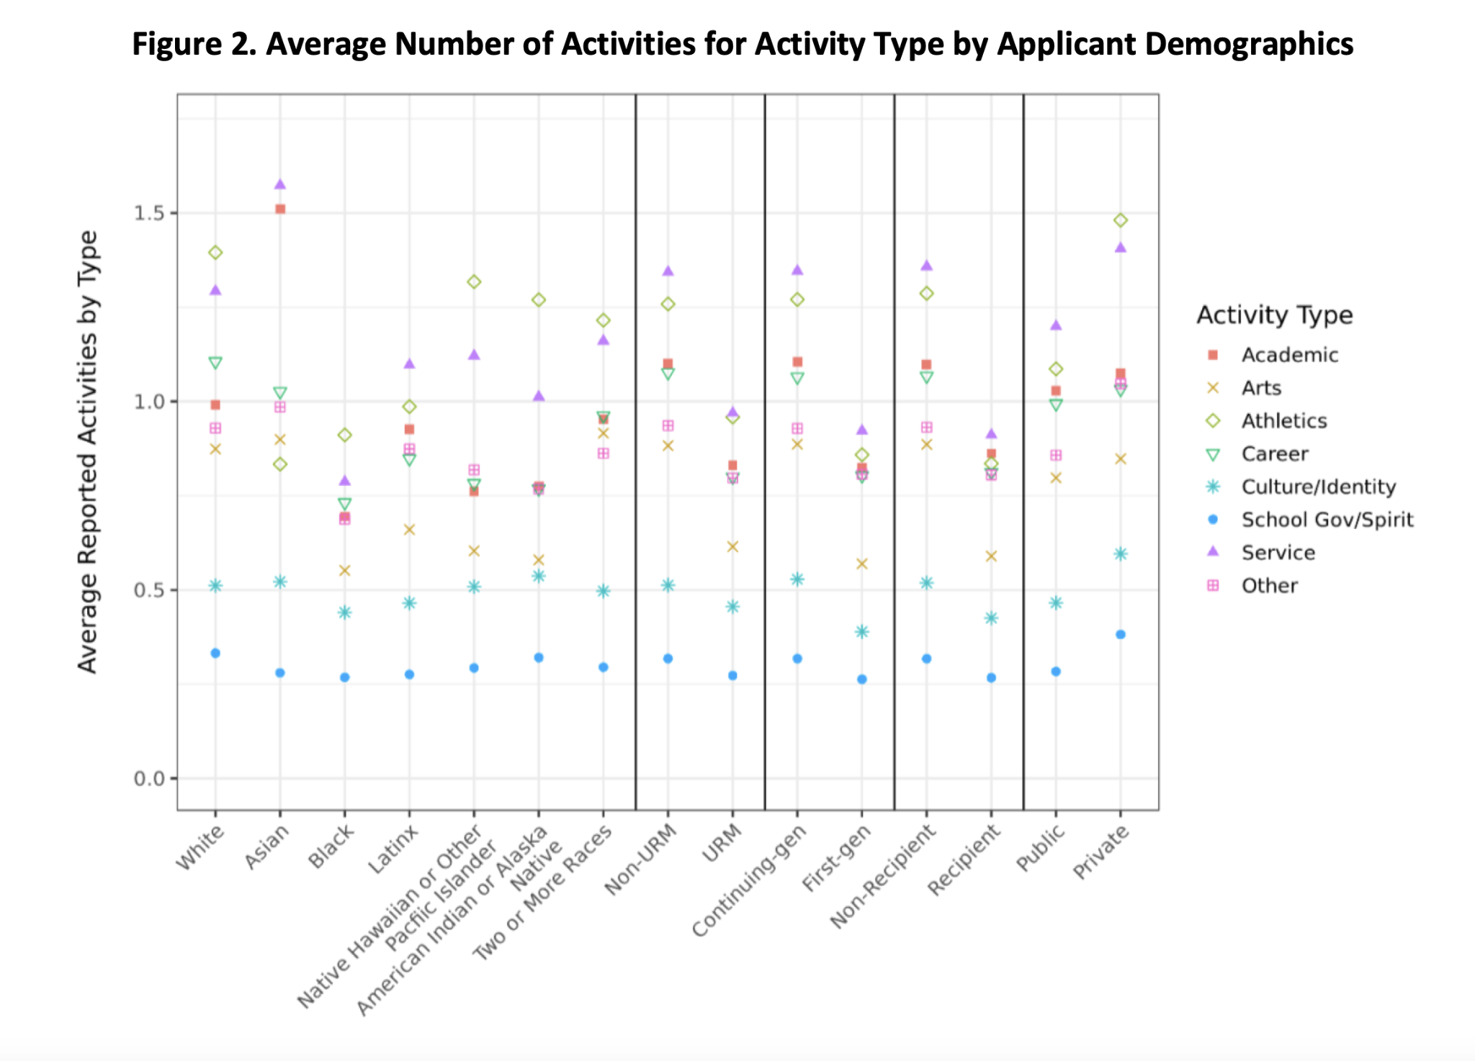
Text only?
Which demographic group reportedly
participates in
the most athletics?
ChatGPT & Claude 3.7: “Figure shows average extracurricular activities by demographic groups (race/ethnicity, URM status, first-generation status, financial aid status, and school type). Service and athletics are most common across groups, while culture/identity activities are consistently less reported. Data reveals participation disparities likely influenced by socioeconomic factors, institutional opportunities, and community priorities.”
https://www.the74million.org/article/14-charts-that-changed-the-way-we-looked-at-americas-schools-in-2023/
Notes:
(Z) How much text would we need to effectively represent this figure in english?

Slide 3
CYMBAL
PRODUCT OVERVIEW
WHAT IS MIR, RAG, NLP?
HISTORY OF NLP
WHAT IS RAG
Notes:
(Z)

Slide 4
HISTORY OF NLP
WHAT IS RAG
ChatGPT GPT-4 released (March 2023)
Transformer architecture introduced (2017)
ColPali release (Jun 2024)
RIGHT NOW
1970
1990
2010
2015
2020
2025
Feb
March
April
First question answering systems described by research
Word2Vec
released (2013)
ChatGPT using GPT-3.5 released (Nov 2022)
ViDoRAG (25 Feb)
Ask Jeeves (Ask.com) (1997)
BERT released (2018)
MMDocIR Benchmark release (26 Jan)
Notes:
(Z)

Slide 5
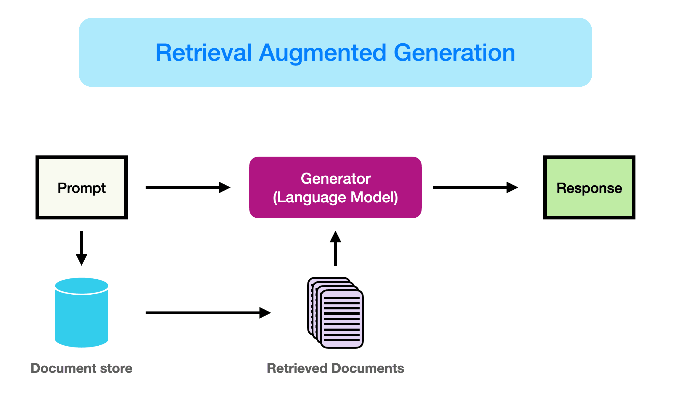
RAG IS
THE FUTURE
What is RAG?
https://www.promptingguide.ai/research/rag
Notes:
(L) What were the baseball scores today?

Slide 6
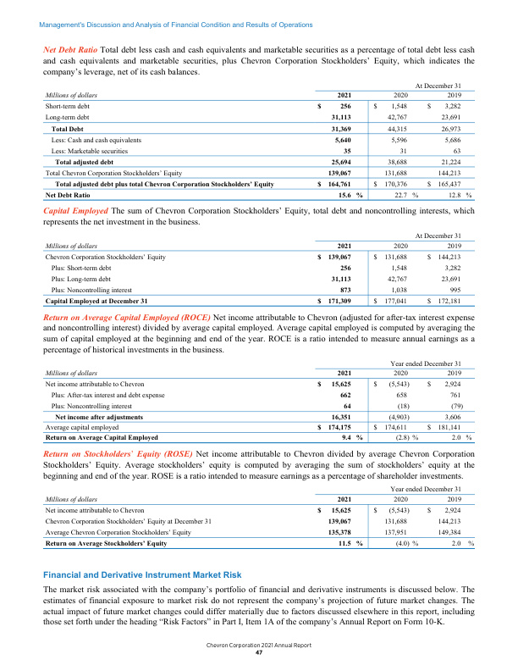
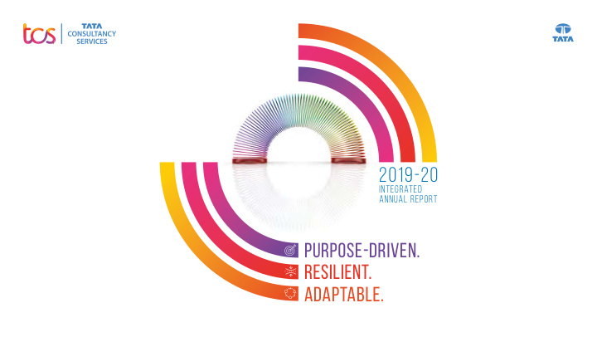
RAG IS
THE FUTURE
Retrieved Document
Notes:
(L) What do you do when your documents aren’t just text? Example images from MMDocIR-Challenge set

Slide 7
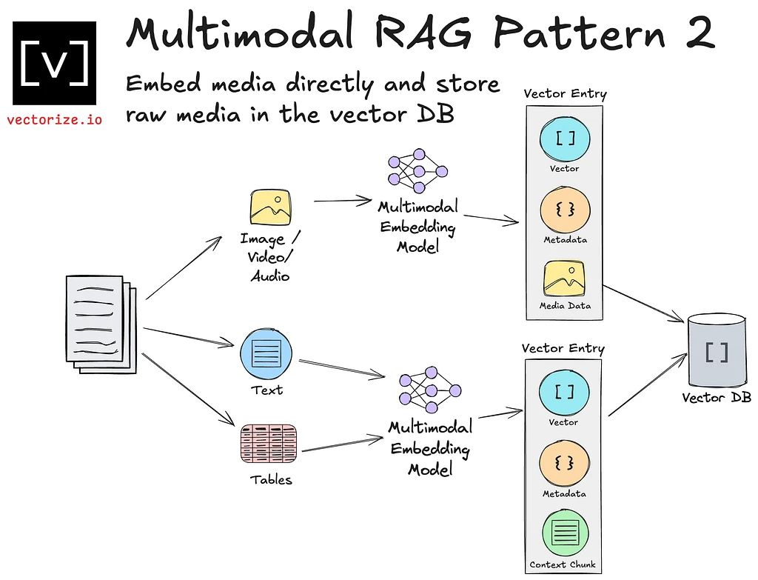
RAG IS
THE FUTURE
Retrieved Document
Notes:
(L)

Slide 8
CYMBAL
PRODUCT OVERVIEW
The Challenge
RAG IS
COMPLICATED
Notes:
(Z)

Slide 9
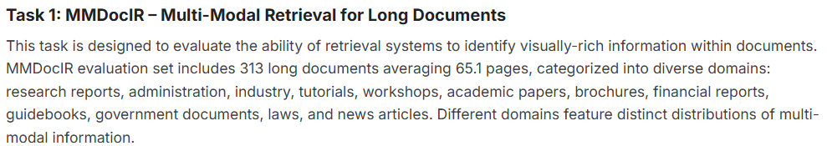
RAG IS
COMPLICATED
MMDocIR-Challenge
Notes:
(Z) This – is what we started with exactly 21 days ago when Luis and I foolishly decided to try something new

Slide 10
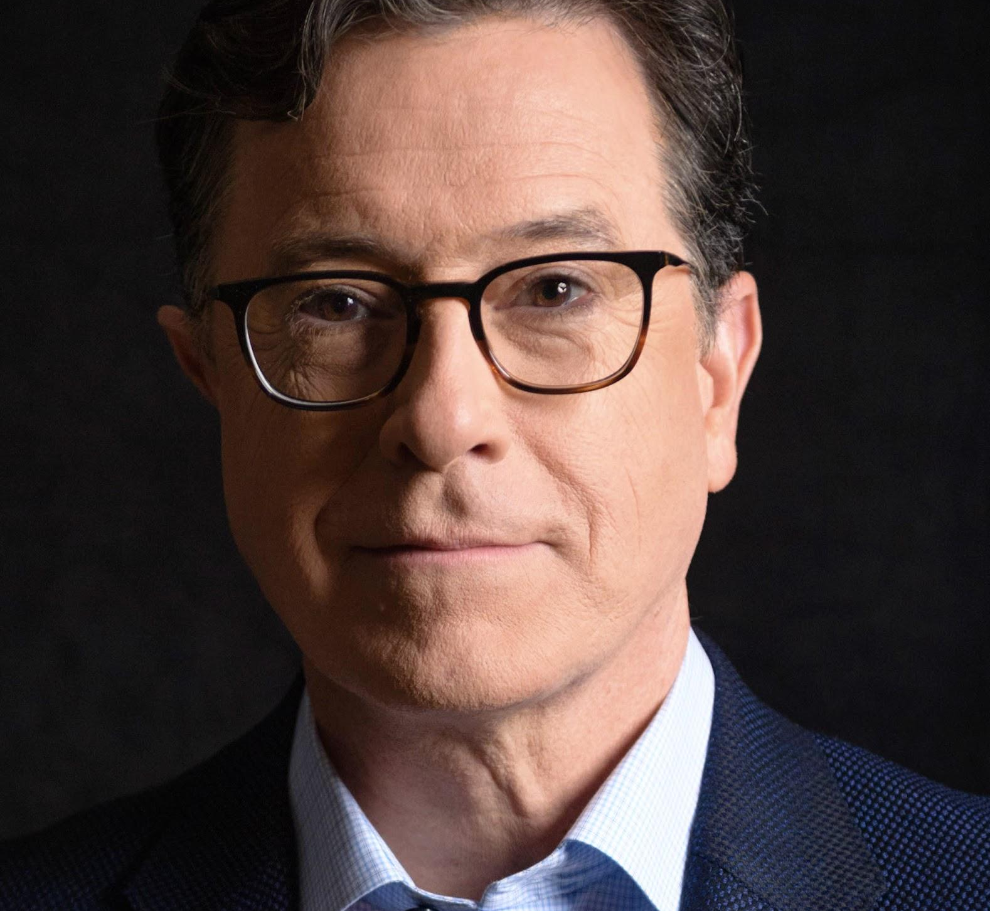
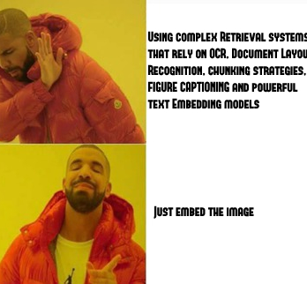
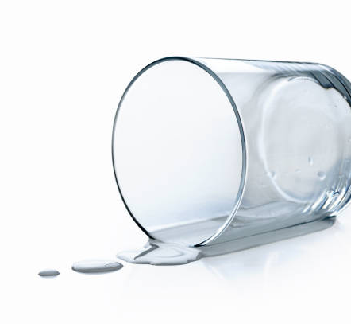
Our approach
ColBERT
Colpali / ColQwen
Less than vanilla RAG
Contextualized late interaction BERT
Using Vision LLMs + late interaction to improve document retrieval (RAG, search engines, etc.), solely using the image representation of document pages
Only algorithms, no language model or embedding.
Notes:
(L)

Slide 11
Our approach
ColBERT
Colpali / ColQwen
Less than vanilla RAG
DID NOT WORK! Memory issues.
DID NOT WORK! Memory issues.
WORKED! Provided output, however poor the quality
Notes:
(L)

Slide 12
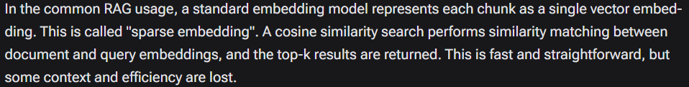
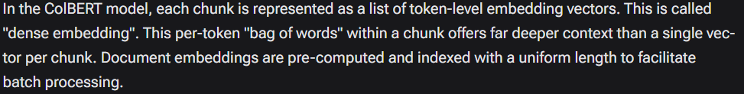
colBERT deep dive
RAG IS
NOT ENOUGH??

Slide 13
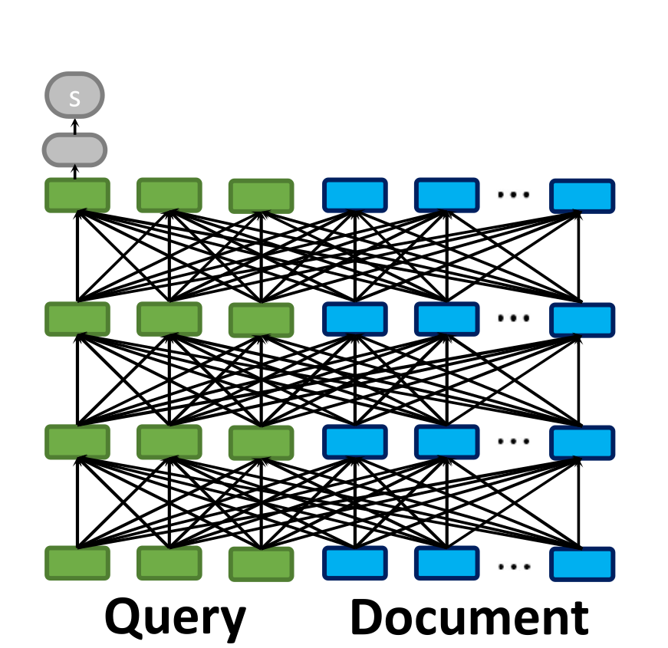
A note on BERT
RAG IS
NOT ENOUGH??
Bidirectional context.
Masked Language Model
Next Sentence Prediction
“All-to-all Interaction”
Notes:
(L)

Slide 14
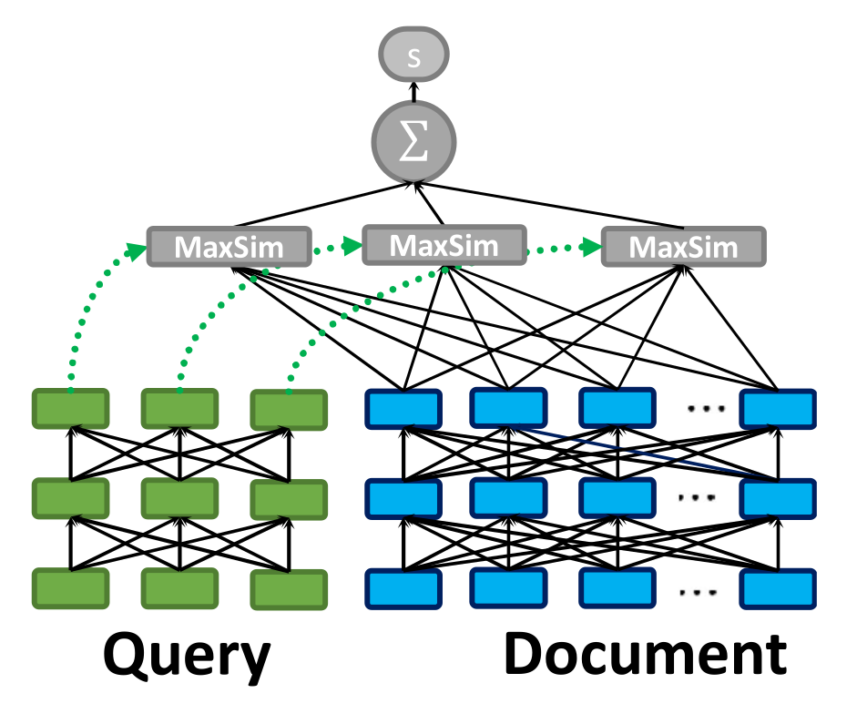
ColBERT
RAG IS
NOT ENOUGH??
Figure 1: ColBERT's late interaction, efficiently scoring the fine-grained similarity between a queries and a passage.
As Figure 1 illustrates, ColBERT relies on fine-grained contextual late interaction: it encodes each passage into a matrix of token-level embeddings (shown above in blue). Then at search time, it embeds every query into another matrix (shown in green) and efficiently finds passages that contextually match the query using scalable vector-similarity (MaxSim) operators.
These rich interactions allow ColBERT to surpass the quality of single-vector representation models, while scaling efficiently to large corpora.
“Late Interaction”
ColBERT = Contextualized Late Interaction over BERT
! Hybrid approach that balances the trade off between effectiveness and efficiency in large-scale information retrieval tasks
! * Late interaction - encode queries and documents separately, interacts with them late in the process (after they’ve been embedded in vector space). Allows to avoid costly computation of pairwise interactions every step.
! * Contextualized Embeddings - BERT. Produce
Notes:
(L)

Slide 15
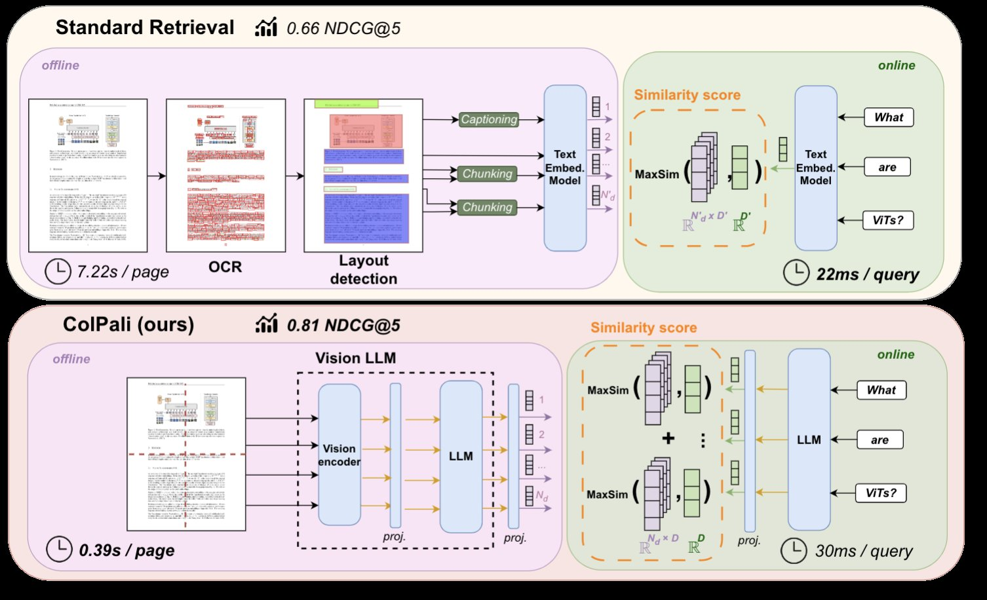
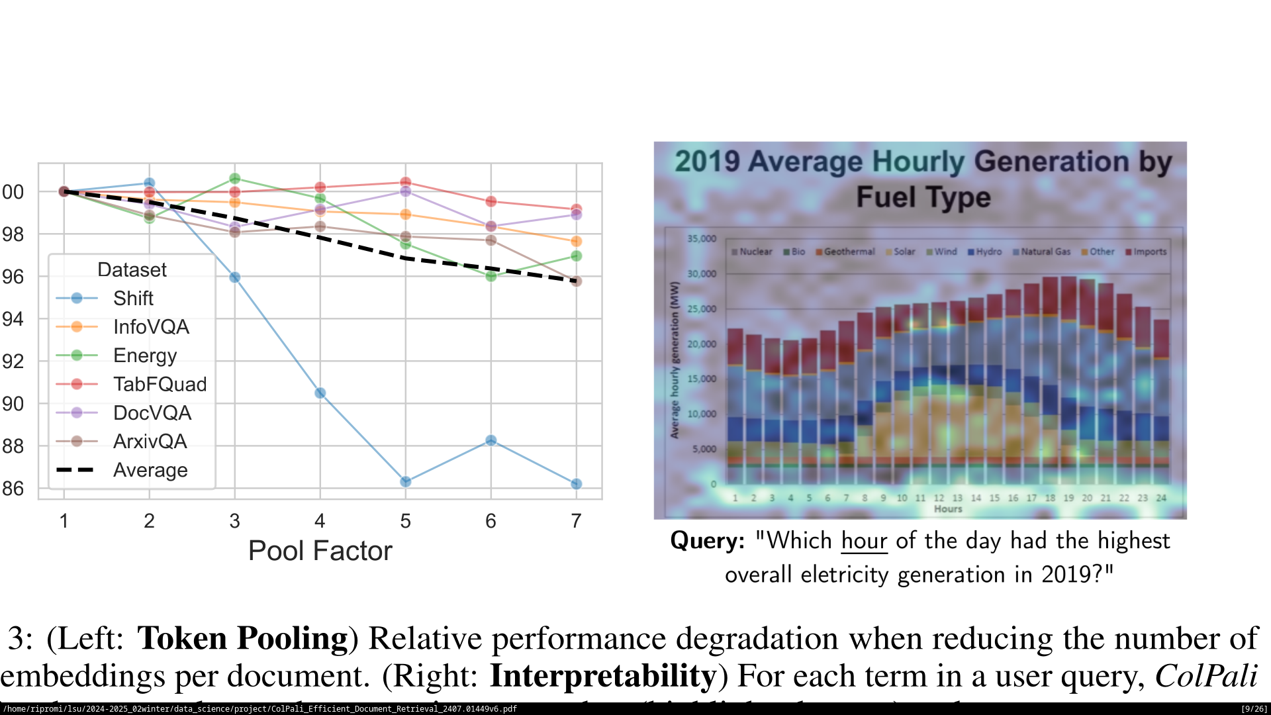
ColPali
RAG IS
STILL NOT ENOUGH??
Notes:
(L)

Slide 16
ColPali
RAG IS
STILL NOT ENOUGH??
Notes:
(L)

Slide 17
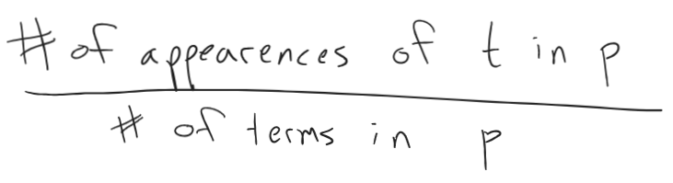
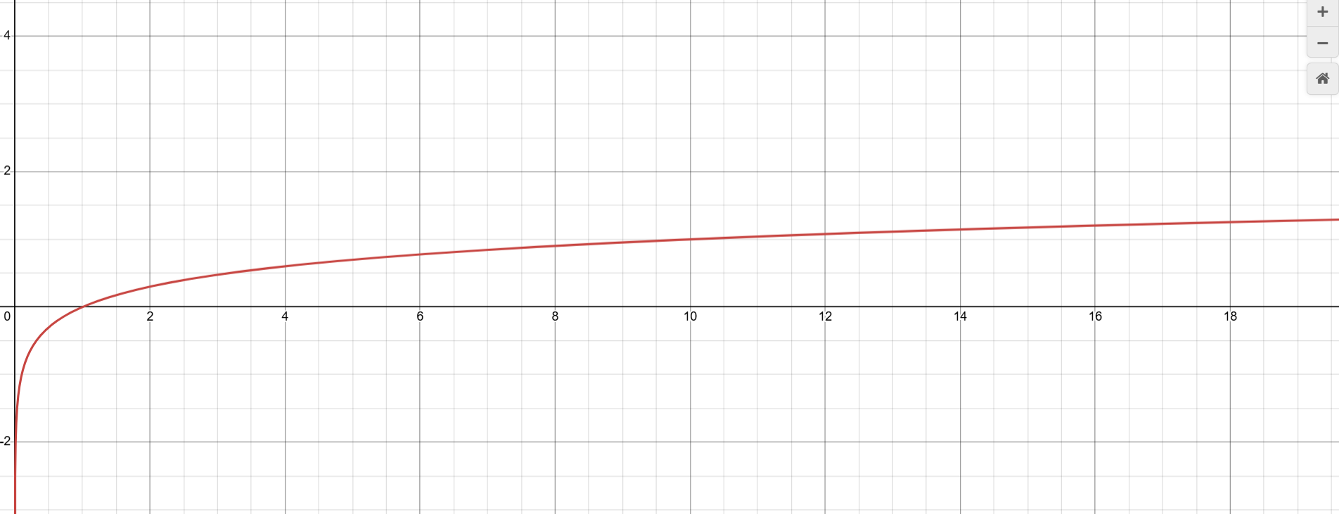
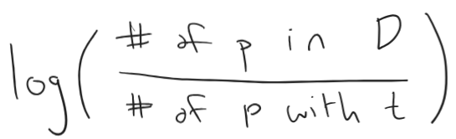
vanilla deep dive: TF-IDF
RAG IS
ENOUGH... PHEW
TF:
IDF:
Notes:
(Z)

Slide 18
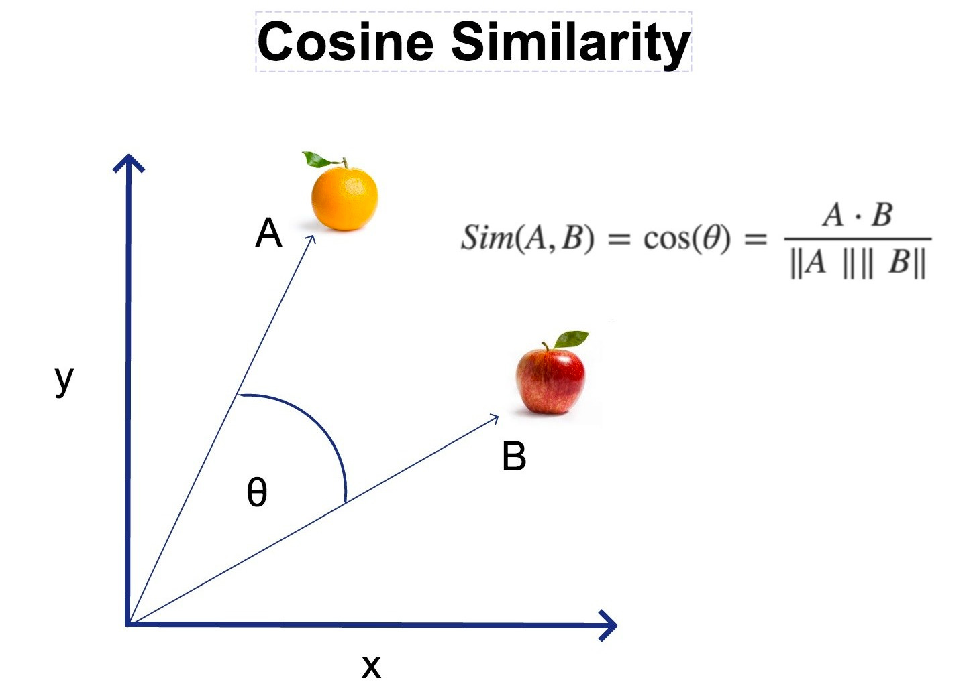
vanilla deep dive: cosine similarity
RAG IS
ENOUGH... PHEW
https://businessanalytics.substack.com/p/cosine-similarity-explained
Notes:
(Z) A is our query, B is our passage

Slide 19
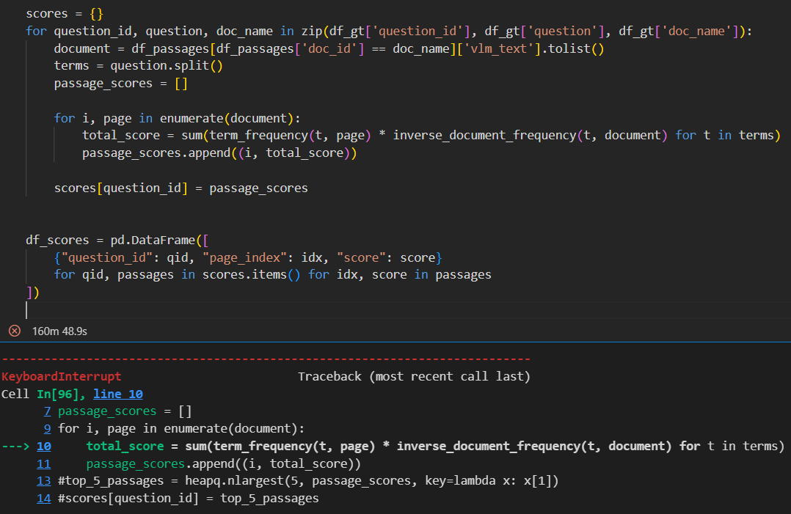
Results
TF-IDF
Notes:
(Z) failed fast failed hard

Slide 20
THANK YOU

Slide 21
Sources
https://docs.datastax.com/en/ragstack/colbert/index.html
https://huggingface.co/blog/manu/colpali
https://www.kaggle.com/competitions/multimodal-document-retrieval-challenge

